Slide 1
Pre-calc trig
Day 31

Slide 2
Review for 10 minutes the following problems…
Ensure anything you have questions on, are discussed in small groups, and add any info to your notes from your discussion that might be helpful.

Slide 3
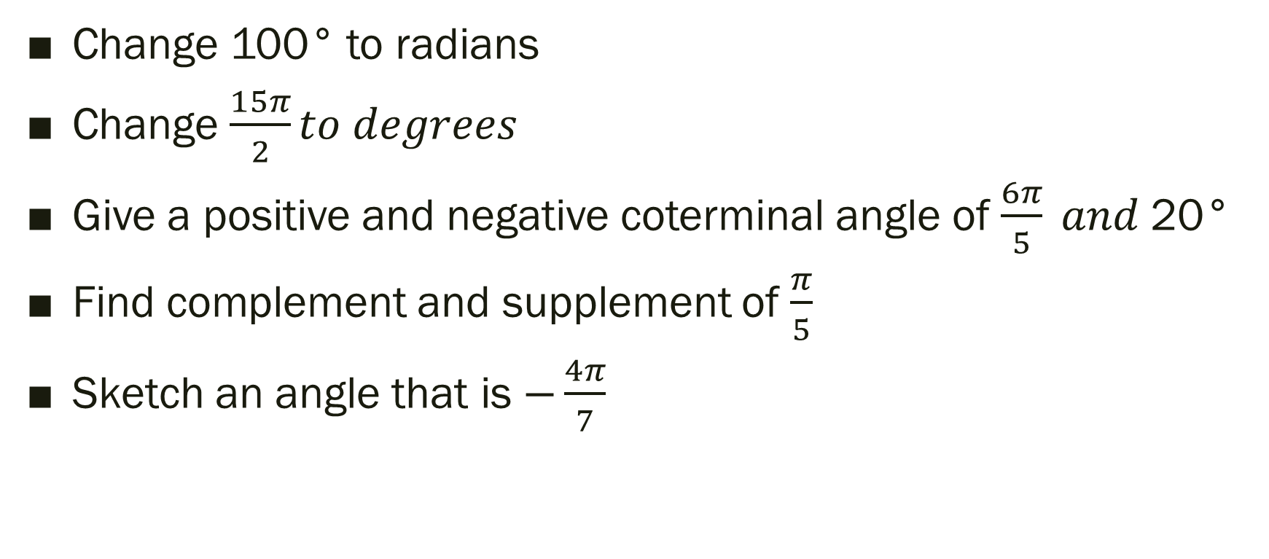
“Practice Test” Level 2 Conversions
Change 100° to radians
Change $\frac{15π}{2}to degrees$
Give a positive and negative coterminal angle of $\frac{6π}{5} and$20°
Find complement and supplement of $\frac{π}{5}$
Sketch an angle that is $−\frac{4π}{7}$

Slide 4
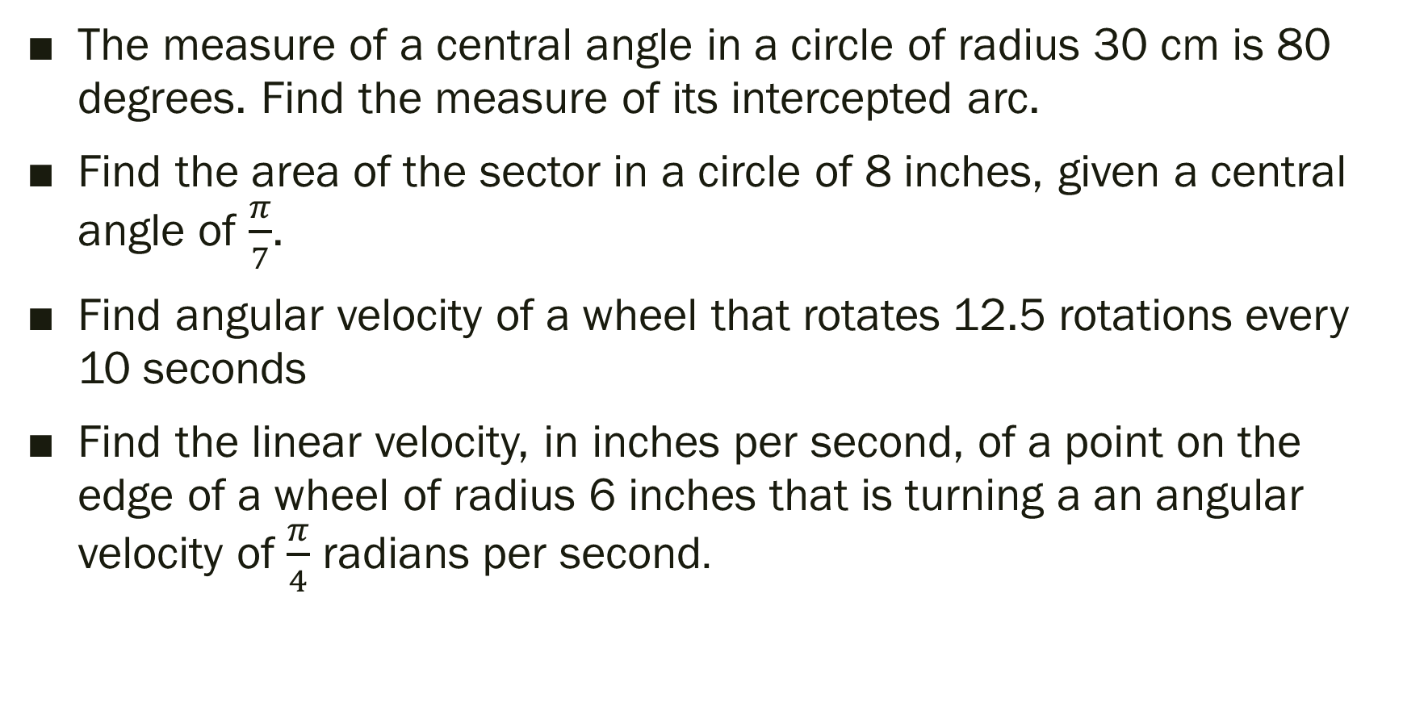
“Practice Test” Level 2 Applied
The measure of a central angle in a circle of radius 30 cm is 80 degrees. Find the measure of its intercepted arc.
Find the area of the sector in a circle of 8 inches, given a central angle of $\frac{π}{7}$.
Find angular velocity of a wheel that rotates 12.5 rotations every 10 seconds
Find the linear velocity, in inches per second, of a point on the edge of a wheel of radius 6 inches that is turning a an angular velocity of $\frac{π}{4}$ radians per second.

Slide 5
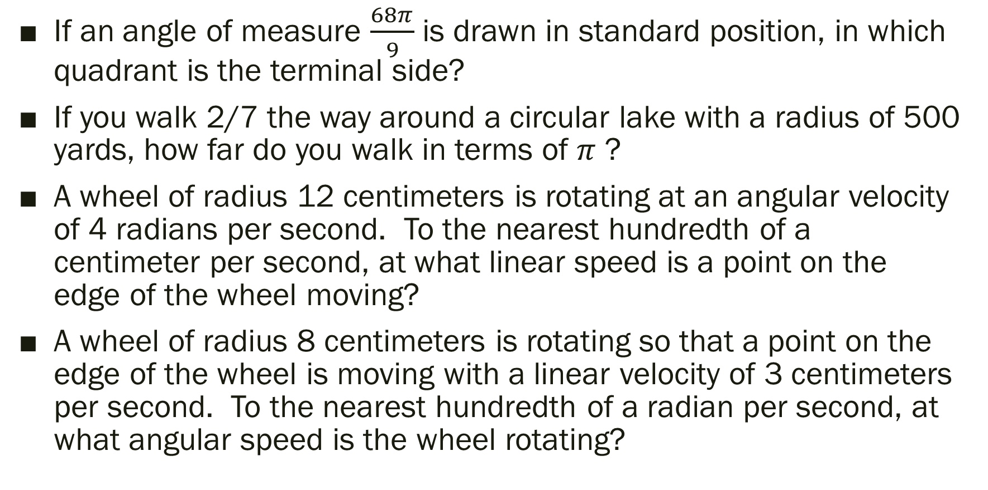
“Practice Test” Level 3
If an angle of measure $\frac{68π}{9}$ is drawn in standard position, in which quadrant is the terminal side?
If you walk 2/7 the way around a circular lake with a radius of 500 yards, how far do you walk in terms of $π$ ?
A wheel of radius 12 centimeters is rotating at an angular velocity of 4 radians per second. To the nearest hundredth of a centimeter per second, at what linear speed is a point on the edge of the wheel moving?
A wheel of radius 8 centimeters is rotating so that a point on the edge of the wheel is moving with a linear velocity of 3 centimeters per second. To the nearest hundredth of a radian per second, at what angular speed is the wheel rotating?

Slide 6
“Practice Test” Level 4
At what angular velocity, in radians per second, should the wheels on a bike with 32-inch diameter wheels be turning so that the bike is traveling at 15 miles per hour? (to the nearest hundredth)
Note: (5280 feet =1 mile, 60 minutes=1 hour, 60 seconds=1 minute)

Slide 7
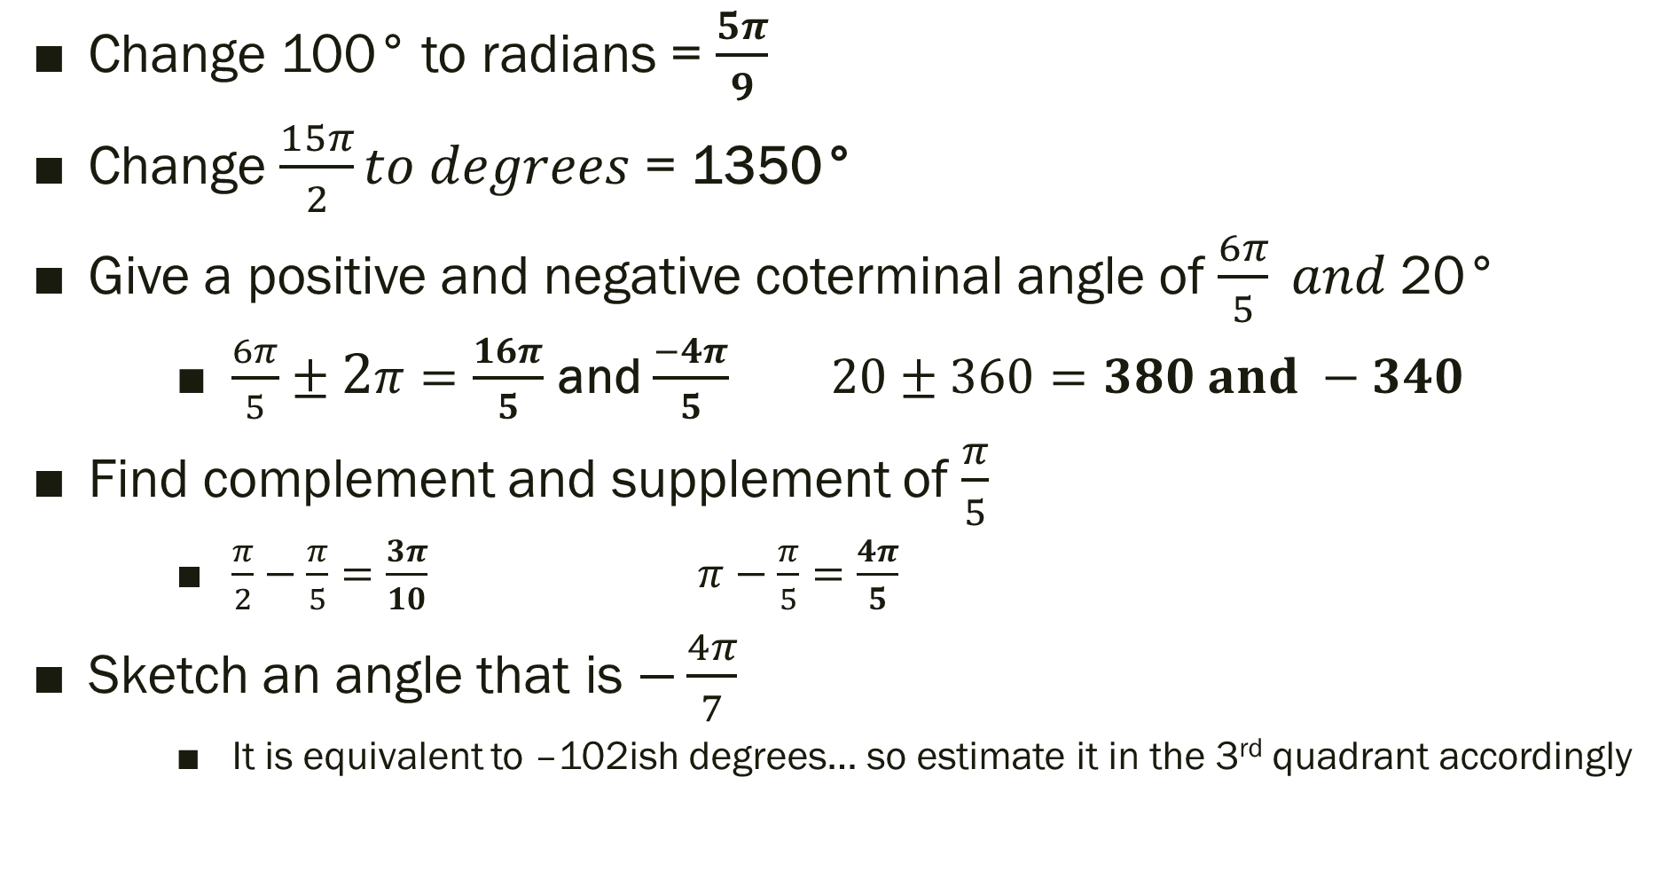
“Practice Test” Level 2 Conversions SOLUTIONS
Change 100° to radians = $\frac{5π}{9}$
Change $\frac{15π}{2}to degrees$ = 1350°
Give a positive and negative coterminal angle of $\frac{6π}{5} and$20°
$\frac{6π}{5}±2π=\frac{16π}{5}$ and $\frac{−4π}{5}$ $20±360=380 and −340$
Find complement and supplement of $\frac{π}{5}$
$\frac{π}{2}−\frac{π}{5}=\frac{3π}{10}$ $π−\frac{π}{5}=\frac{4π}{5}$
Sketch an angle that is $−\frac{4π}{7}$
It is equivalent to –102ish degrees… so estimate it in the 3rd quadrant accordingly

Slide 8
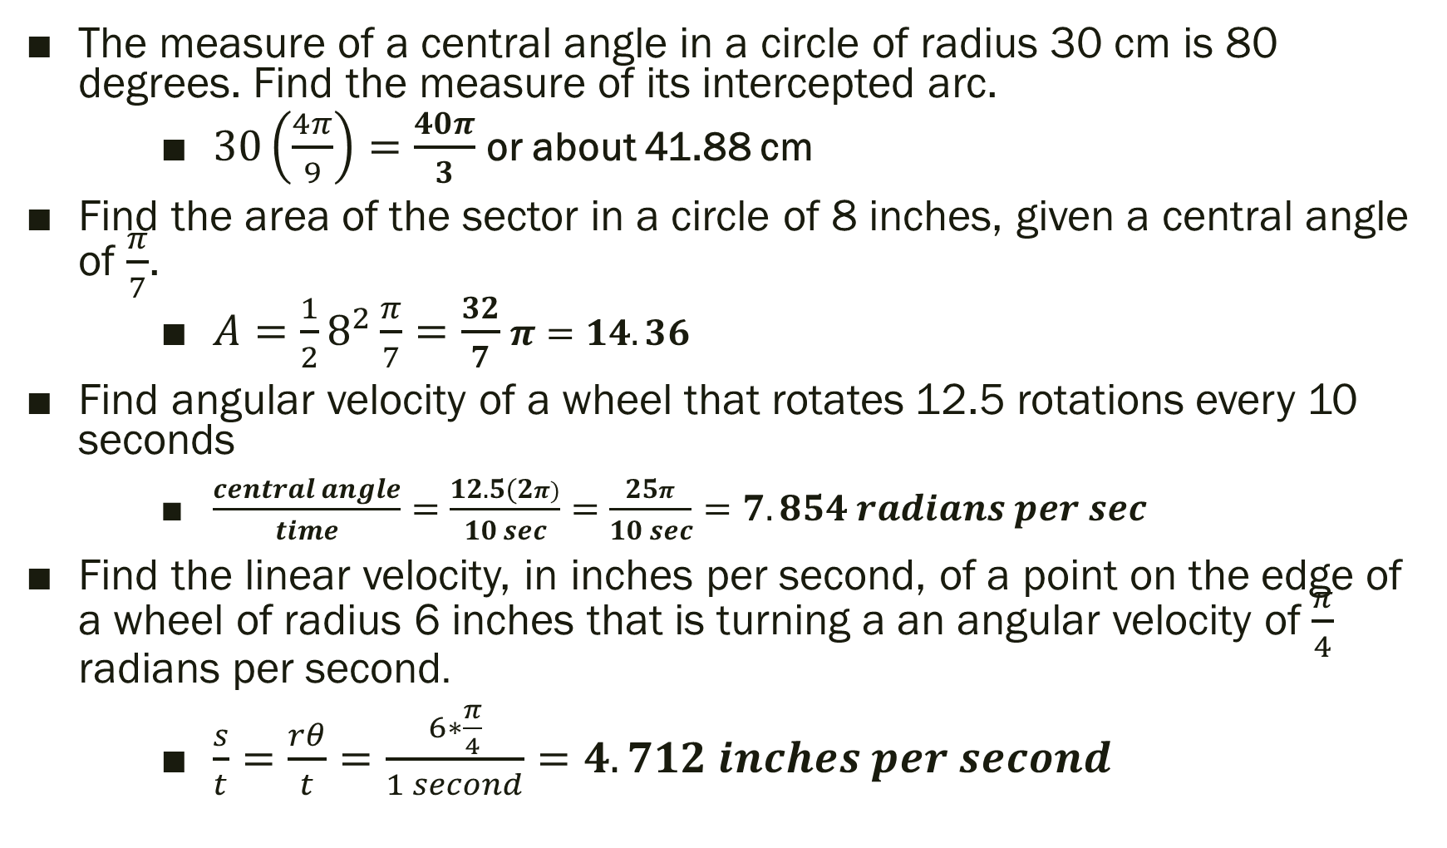
“Practice Test” Level 2 Applied SOLUTION
The measure of a central angle in a circle of radius 30 cm is 80 degrees. Find the measure of its intercepted arc.
$30\left(\frac{4π}{9}\right)=\frac{40π}{3}$ or about 41.88 cm
Find the area of the sector in a circle of 8 inches, given a central angle of $\frac{π}{7}$.
$A=\frac{1}{2}8^{2}\frac{π}{7}=\frac{32}{7}$ $π=14.36$
Find angular velocity of a wheel that rotates 12.5 rotations every 10 seconds
$\frac{central angle}{time}=\frac{12.5(2π)}{10 sec}=\frac{25π}{10 sec}=7.854 radians per sec$
Find the linear velocity, in inches per second, of a point on the edge of a wheel of radius 6 inches that is turning a an angular velocity of $\frac{π}{4}$ radians per second.
$\frac{s}{t}=\frac{rθ}{t}=\frac{6∗\frac{π}{4}}{1 second}=4.712 inches per second$

Slide 9
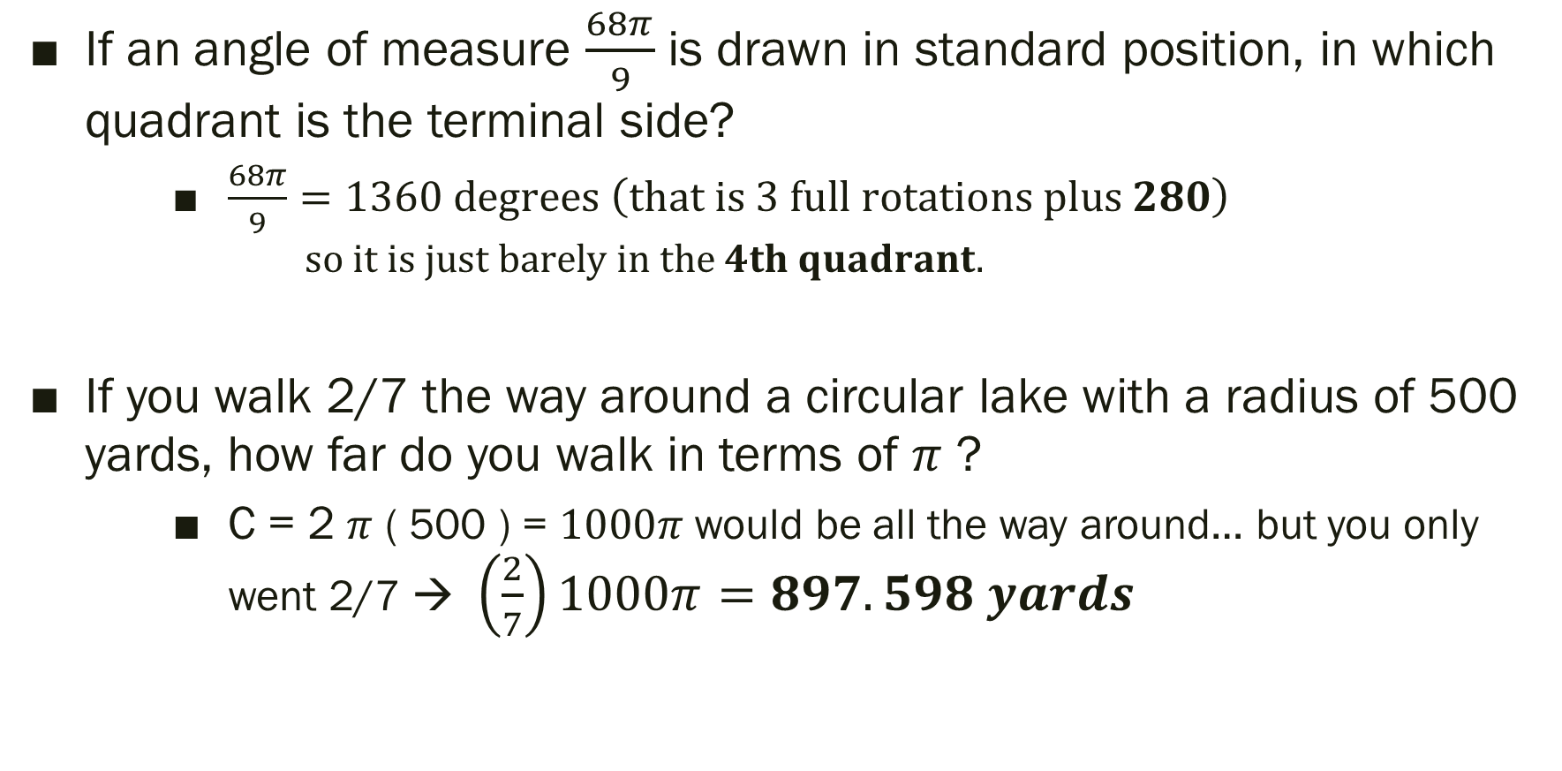
“Practice Test” Level 3 SOLUTIONS
If an angle of measure $\frac{68π}{9}$ is drawn in standard position, in which quadrant is the terminal side?
$\frac{68π}{9}=1360 degrees \left(that is 3 full rotations plus 280\right)$
$$so it is just barely in the 4th quadrant.$$
If you walk 2/7 the way around a circular lake with a radius of 500 yards, how far do you walk in terms of $π$ ?
C = 2 $π$ ( 500 ) = $1000π$ would be all the way around… but you only went 2/7 → $\left(\frac{2}{7}\right)1000π=897.598 yards$

Slide 10
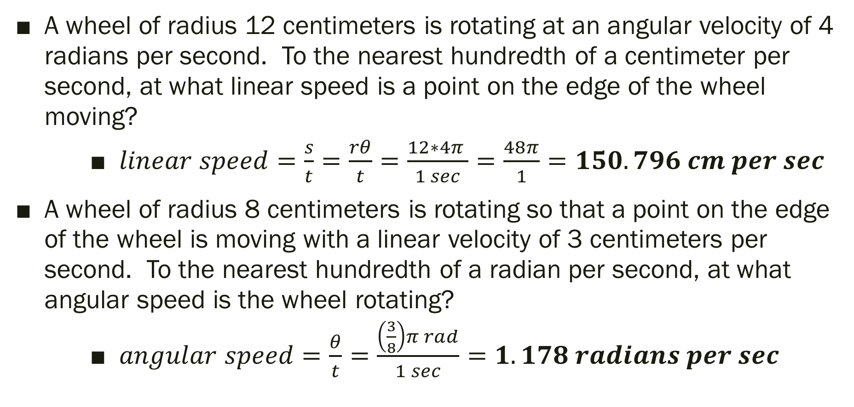
“Practice Test” Level 3 SOLUTIONS
A wheel of radius 12 centimeters is rotating at an angular velocity of 4 radians per second. To the nearest hundredth of a centimeter per second, at what linear speed is a point on the edge of the wheel moving?
$linear speed=\frac{s}{t}=\frac{rθ}{t}=\frac{12∗4π }{1 sec}=\frac{48π}{1}=150.796 cm per sec$
A wheel of radius 8 centimeters is rotating so that a point on the edge of the wheel is moving with a linear velocity of 3 centimeters per second. To the nearest hundredth of a radian per second, at what angular speed is the wheel rotating?
$angular speed=\frac{θ}{t}=\frac{\left(\frac{3}{8}\right)π rad}{1 sec}=1.178 radians per sec$

Slide 11
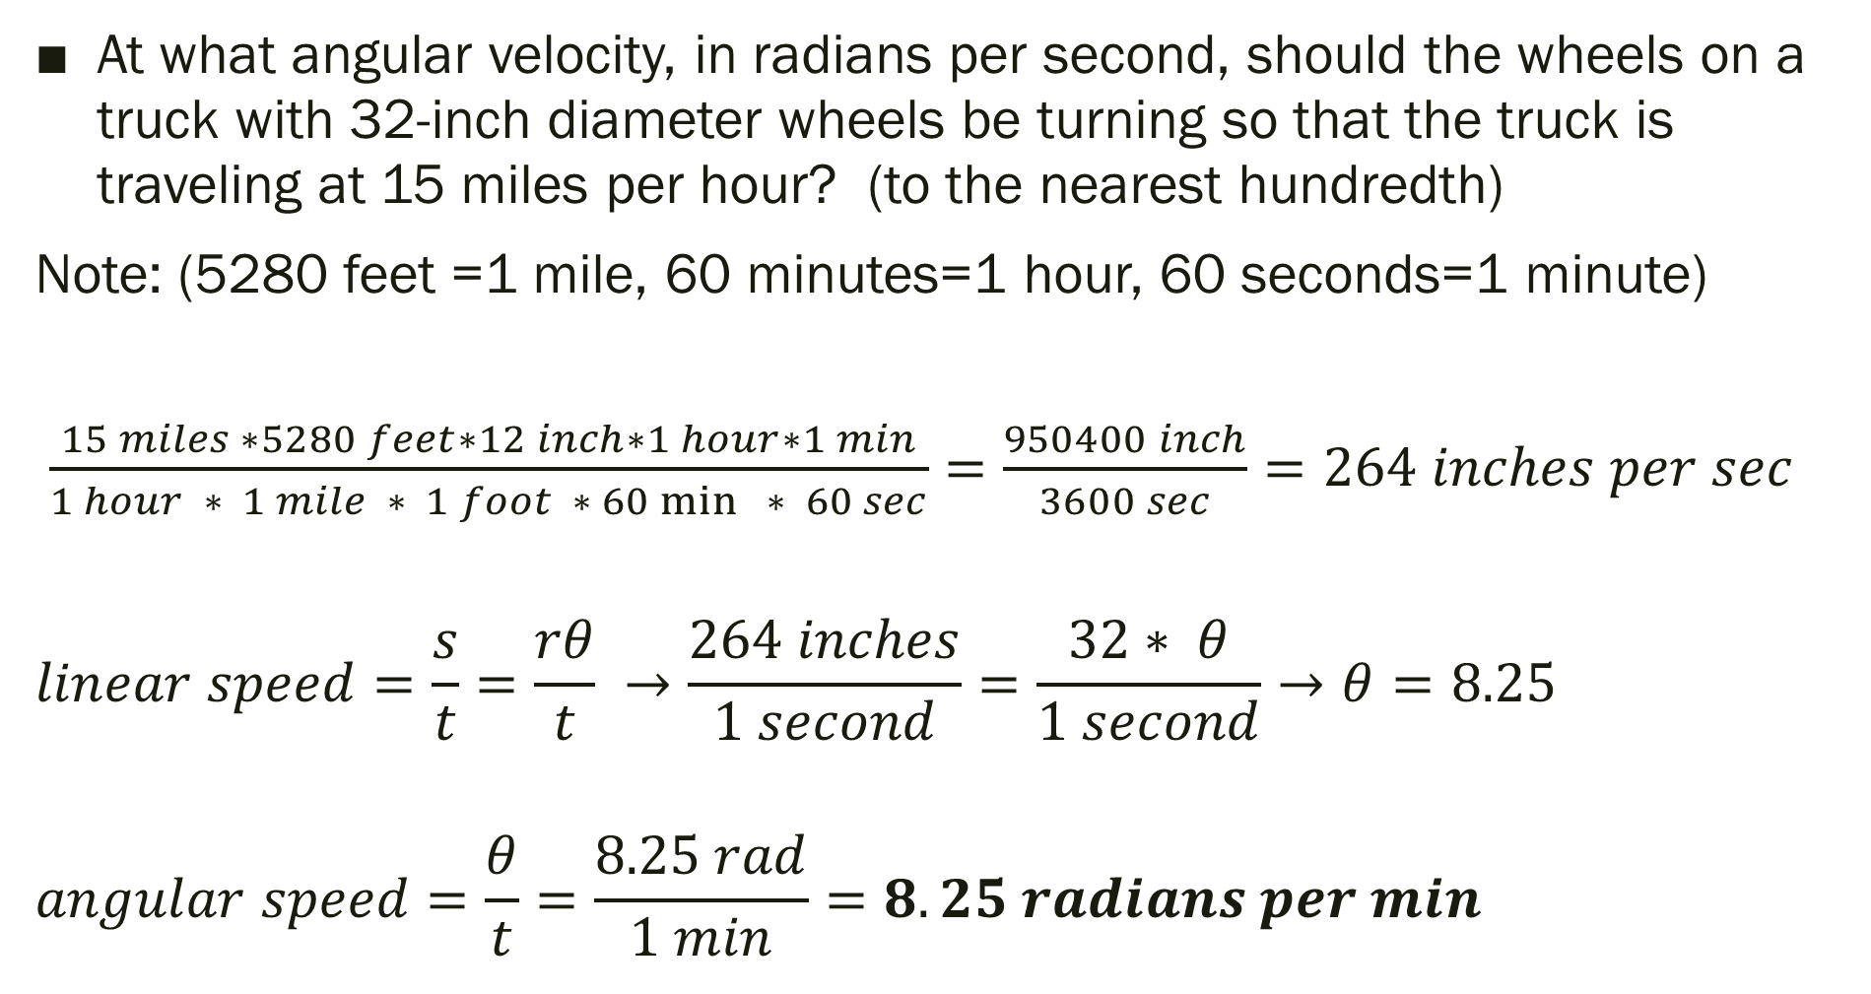
“Practice Test” Level 4 SOLUTIONS
At what angular velocity, in radians per second, should the wheels on a truck with 32-inch diameter wheels be turning so that the truck is traveling at 15 miles per hour? (to the nearest hundredth)
Note: (5280 feet =1 mile, 60 minutes=1 hour, 60 seconds=1 minute)
$\frac{15 miles ∗5280 feet∗12 inch∗1 hour∗1 min}{1 hour ∗ 1 mile ∗ 1 foot ∗ 60\min{ }∗ 60 sec}=\frac{950400 inch}{3600 sec}=264 inches per sec$
$$linear speed=\frac{s}{t}=\frac{rθ}{t} →\frac{264 inches}{1 second}=\frac{32∗ θ}{1 second}→θ=8.25$$
$$angular speed=\frac{θ}{t}=\frac{8.25 rad}{1 min}=8.25 radians per min$$

Slide 12
Test
You may use a calculator
(even on the parts it says “no calculator”)
You may use your notes
GOOD LUCK!

